Slide 1


ORAL PRESENTATION:
TALKING ABOUT my life AND MY JOB

Slide 2
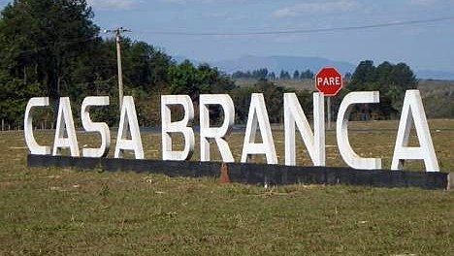
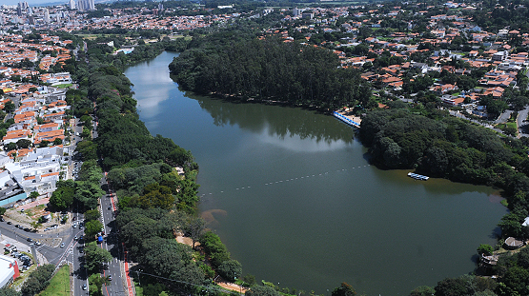
Who am i?
Name
age
hometown
where i live

Slide 3
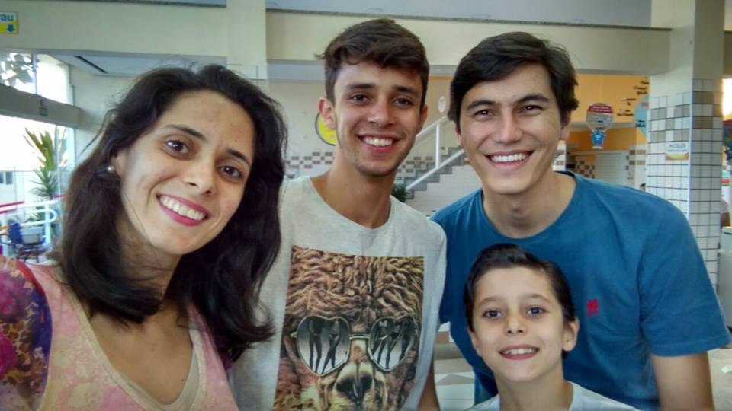
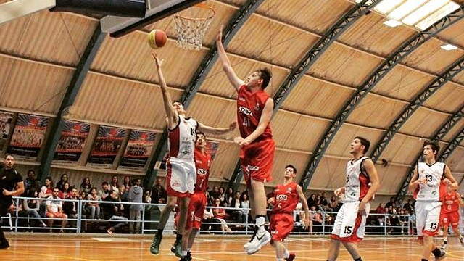
Who am i?
marital status
Family
pets
hobbies

Slide 4


My job
Company
Working time
my position
opinion about my job

Slide 5
Use of english
First contact
How i pratice
Importance of english in the area

Slide 6

Plans for my future
Motivation

Slide 7
Student:
Antônio pires felipe

